Slide 1
CPU SCHEDULING SOFTWARE
MADE BY
Virendra Pandey
Ashumendra Pratap Singh

Slide 2
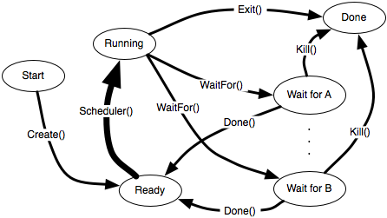
HOW SCHEDULING WORKS

Slide 3
CPU SCHEDULING ALGORITHMS
FIRST COME FIRST SERVE
SHORTEST JOB FIRST
SHORTEST REMAINING TIME
PRIORITY SCHEDULING (NON-PREEMPTIVE)
PRIORITY SCHEDULING (PREEMPTIVE)
ROUND ROBIN SCHEDULING

Slide 4
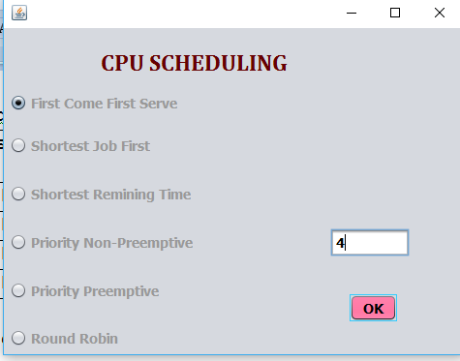
WELCOME PAGE

Slide 5
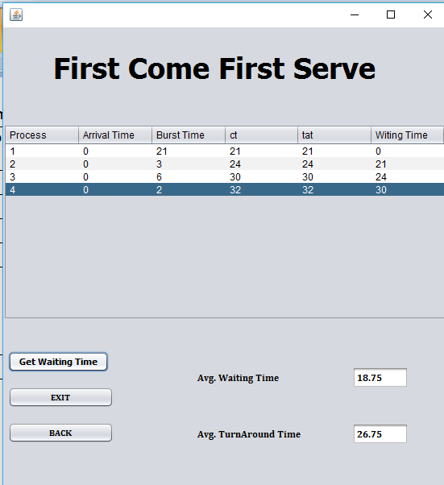
FIRST COME FIRST SERVE

Slide 6
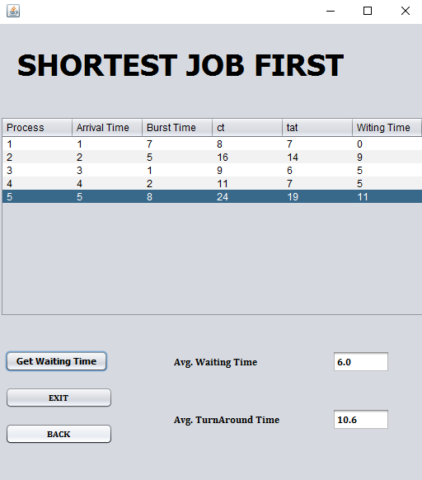
SHORTEST JOB FIRST

Slide 7
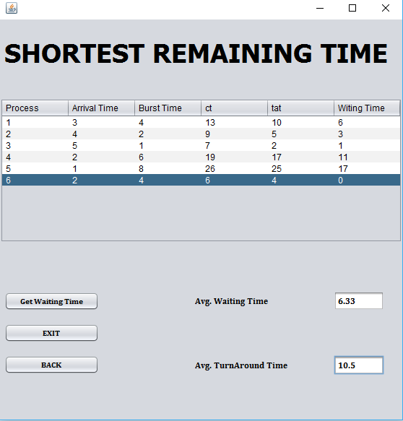
SHORTEST REMAINING TIME

Slide 8
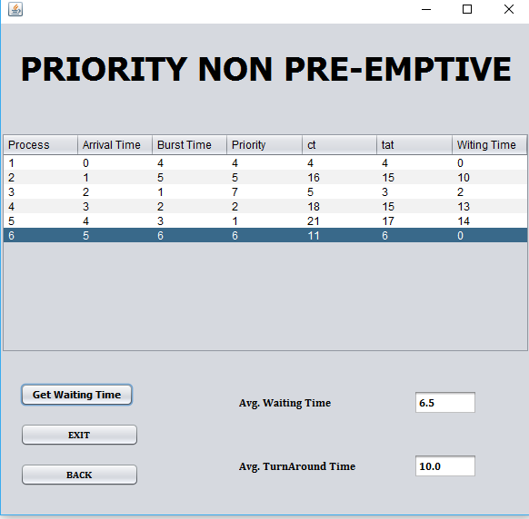
PRIORITY NON-PREEMPTIVE

Slide 9
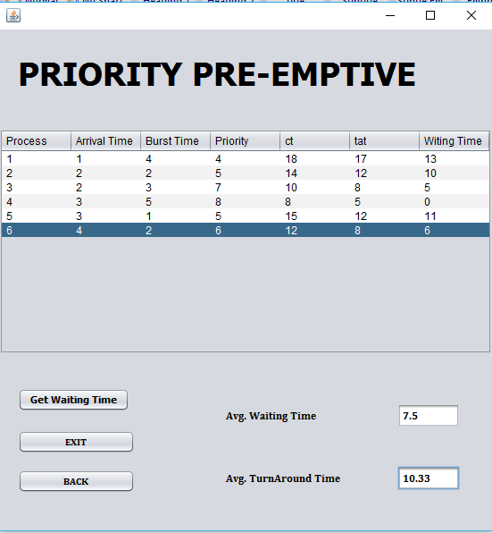
PRIORITY PREEMPTIVE

Slide 10
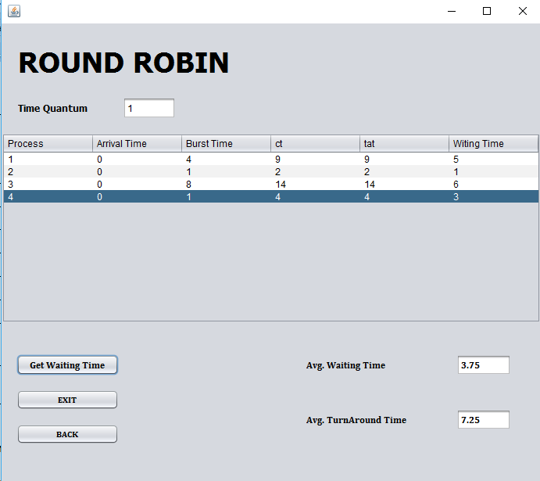
ROUND ROBIN

Slide 11
THANK YOU

